Slide 1
CUTe 7305c
Name: Abhishek Shetty
Batch: 44
Date: 11-Aug-2018
Name: Sravanthi Vedanjla
Batch: 44
Date: 11-Aug-2018
Name:Pranav
Batch: 44
Date: 11-Aug-2018

Slide 2
What is the Business Problem about:
Historical data about given companies based on the details of various markers and financial ratios of entities.
Data includes 64 attributes with various features of historical data such as liabilities , profits , assets , loss and gains of the company
Objective:
Identify the best algorithm to predict whether the company goes bankrupt
What approach was used:
Understanding the data
Division of data into train and validation
Preprocessing of the split data
Identify a ML algorithm to devise a basic model predicting best F1 score
Improve on the model accuracy until we achieve the factors we assume is best suited for the given data

Slide 3

Understanding the data:
High Imbalance data , with more number of Zero values , indicating more companies as not bankrupt.
95% companies are non-bankrupt and 5% are bankrupt .
Data seems to be standardized as there are negative values and hence no standardization was done
Percentage of NA values is 44% in Attr 37, and rest of the data shows minimal NA values , hence Data needs to be Imputed
Models Approached:
Random Forest
Step-AIC / VIF
Xg-boost

Slide 4
Exploratory Data Analysis:
Split the data into Train and Validation.
Applying Central Imputation.
Identify Attributes by running Random Forest model based on Gini Index to consider for further Model building.
VarImplot model to determine multi collinearity in the data
Attempt at using Synthetic Mining Oversampling Technique(SMOTE)
Tuning Steps of Hyperparameter used for Model Building Approach:
RandomForest: - Mtry value
Xg Boost : Max_Tree Depth , gamma , etc.

Slide 5
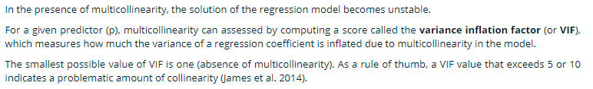
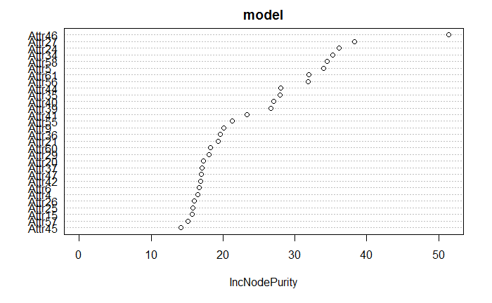
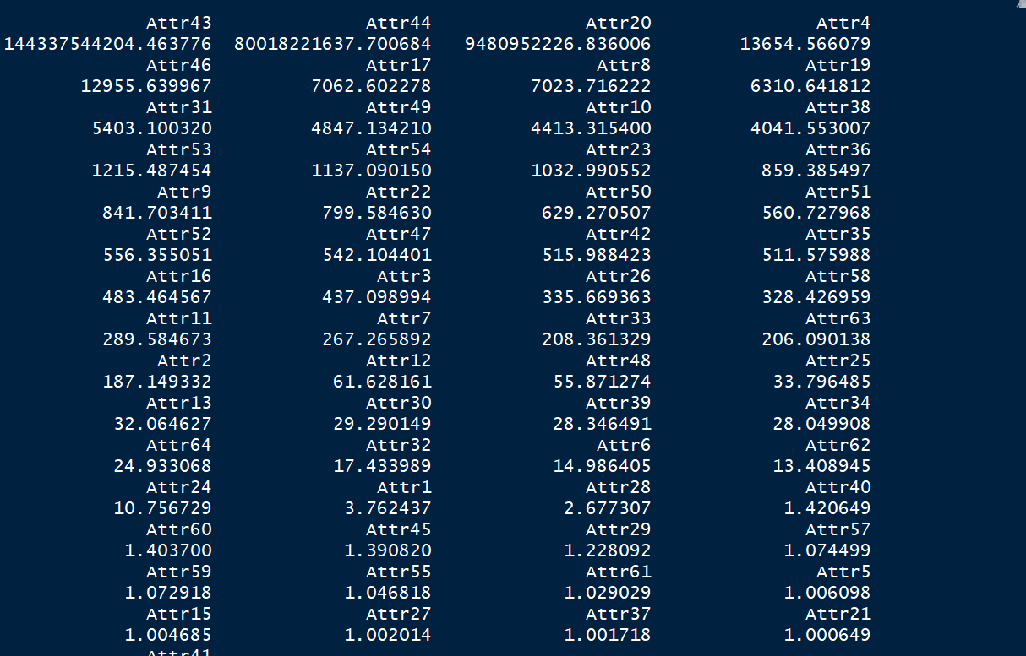
How to arrive at best attributes:

Slide 6
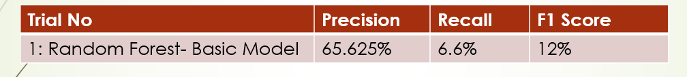
Initial Model Evaluation using Random Forest:
Second Model Evaluation using XgBoost:

Slide 7
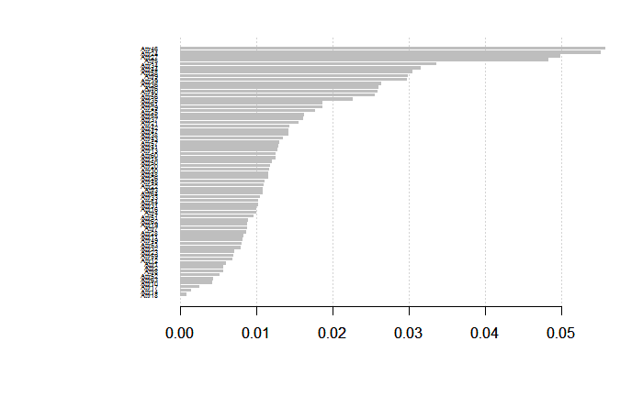
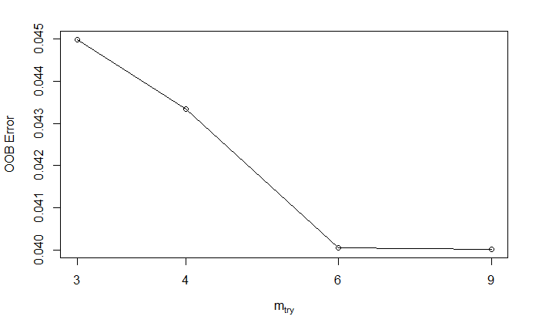
Why did we opt for XgBoost:
Selection of Top important attributes by the model
Selection of best Mtry as Hyper parameter : 6

Slide 8
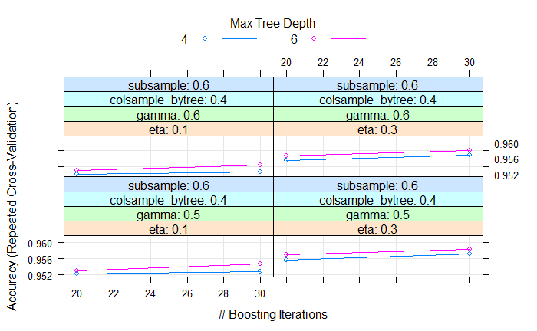
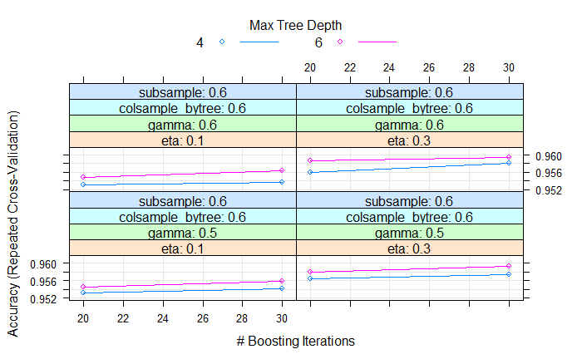

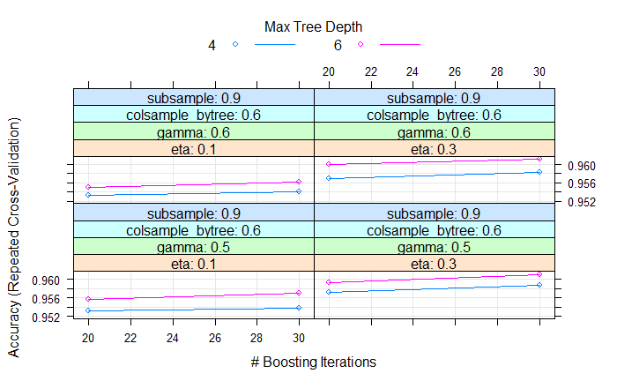
Metrics achieved from Boosting Iterations:

Slide 9
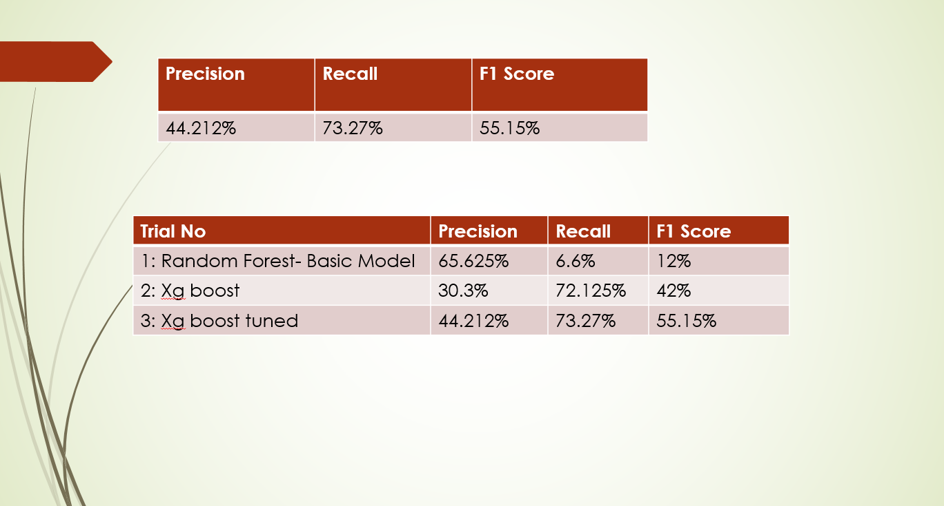
Evaluation Metrics achieved in Test Data

Slide 10
Conclusions:
Xgboost with best tuned the parameters approached to achieve higher recall score
Maximum possible Recall score is 73.17%.
Final Precision is 44.14%.
F1score attained is 55.15%
NO Overfitting observed in the model.

